Slide 1
Crowdsourcing Insights into Problem
Structure for Scientific Discovery
Bart Selman
Carla P. Gomes
Ronan Le Bras (now @ AI2)
Stefano Ermon (now @ Stanford)

Slide 2
Motivation: Automated Scientific Discovery
  Can we use modern automated reasoning tools for scientific discovery?
  Science and scientific discovery are arguably among the most
  impressive demonstrations of human intelligence.
  We will consider two areas:
  1) Finite Mathematics
  2) Materials Science

Slide 3
I Discovery in Finite Mathematics --- A Brief History
In the early days of computing, there was significant optimism
with the discovery of first-order theorem proving procedures.
But, the raw size of search spaces for interesting math proved to
be a daunting challenge. In a sense, the representation language (first-order logic) is too general and unconstrained to effectively explore.
Still, some success stories of automated mathematical discoveries, involving “finite mathematics.” (Objects of interest are finite.)
We only consider cases of true discovery of previously unknown results (i.e. no “re-discovery”).

Slide 4
Discoveries in Discrete Math
  A) 1976 --- Four Color Thm. Four colors suffices to color a planar map. (Haken and Appel) Problem was open since 1852. Essentially solved using an exhaustive “proof by cases.” (two thousand special sub-maps were analyzed. (90% human / 10% machine)
  Proof is now accepted and has been replicated. Considered somewhat unsatisfying / “inelegant” from a math perspective, because the proof does not provide further insights into why the thm is true. Also, how do we know the computer proof is correct? (Do we?)
  B) 1996 --- Robbins algebras are Boolean algebras. Concerns sets of axioms. (McCune) Open since 1933. Proof strategy: clever syntactic re-write of axioms. Several months of cpu time to find the re-write steps. “Semi-human” readable. (30% human / 70% machine)

Slide 5
C) 2014 --- Erdos Discrepancy Problem. Property of sequences of +1/-1. E.g. +1 +1 -1 +1 -1 -1 +1 -1 …
Does the sum (absolute value) over subsequences of this sequence stay within a certain bound, C?
Erdos conjectured (1932): If sequence gets long enough “discrepancy” exceeds any value of C. Lisitsa and Konev (2014) showed every sequence of 1161 or longer exceeds bound of 2 (i.e. C = 2). But, remarkably, they also found a +1/-1 sequence of 1160 elements that stayed within bound of 2.
  (10% human / 90% machine)
Obtained with Boolean Satisfiability solver (20 hrs). Proof trace of 13 gigabytes. Longest proof in history. Proof verified by proof checker. (Contrast two previous results.)

Slide 6
Each result represents a clear new mathematical advance. But, unfortunately, approaches do not provide much insight into the underlying problem domain.
For example, can we understand how certain complex objects (e.g. 1160 long +1/-1 sequence or coloring of sub-map) can be constructed directly using a human-understandable strategy?

Slide 7
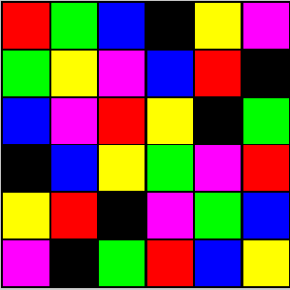
Example Domain:
The Spatially-balanced Latin square (SBLS) problem
  Problem Definition:
  An SBLS of order n is an n x n square grid in which:
Each symbol appears exactly once in each row and column (Latin square structure; multiplication table of quasi-group).
SBLS of order 6
Notes:
To ground our approach in an example domain, I’ll first introduce the SBLS problem. Some of you might be familiar with this combinatorial structure. First, it’s a Latin square, namely a square grid in which each symbol appears exactly once in each row and column. Moreover,

Slide 8
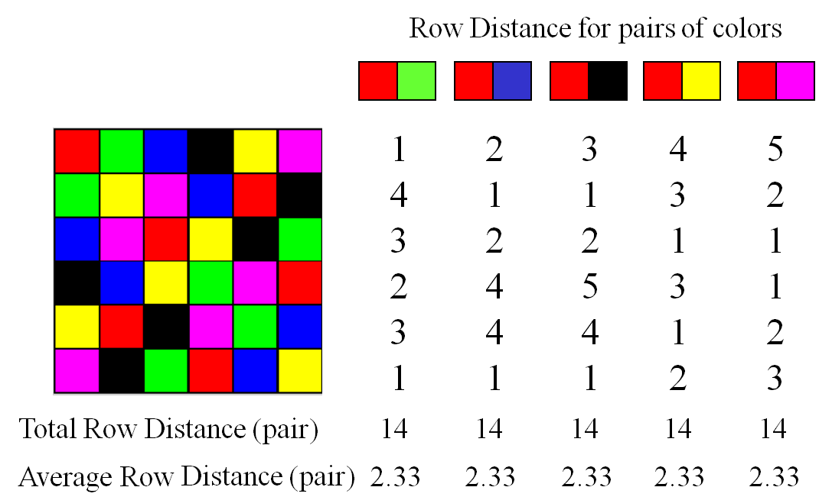
Our Challenge Domain:
The Spatially-Balanced Latin Square (SBLS) problem
  Problem Definition:
  An SBLS of order n is an n x n square grid in which:
Each symbol appears exactly once in each row and column (Latin square structure; multiplication table of quasi-group).
The average distance (column-wise) of a pair of symbols is the same for any pair (Balanced structure).
SBLS of order 6
Notes:
To ground our approach in an example domain, I’ll first introduce the SBLS problem. Some of you might be familiar with this combinatorial structure. First, it’s a Latin square, namely a square grid in which each symbol appears exactly once in each row and column. Moreover,

Slide 9
The Spatially-Balanced Latin Square (SBLS) problem
SBLS of order 6
1
2
14 (avg. 2.33) for all pairs. Use in “experimental design.”
In Computational Sustainability: to limit use of fertilizers.
Designs used by farmers in New York State!
Notes:
To ground our approach in an example domain, I’ll first introduce the SBLS problem. Some of you might be familiar with this combinatorial structure. First, it’s a Latin square, namely a square grid in which each symbol appears exactly once in each row and column. Moreover,

Slide 10
Finding SBLS is very hard.
Approach | Order | Time (s) | Reference
Constraint Programming (CP) | 9 | 241 | [Gomes and Sellmann, CP’04]
IDWalk (metaheuristic) | 9 | 4.5 | [Neveu et al., CP’04]
Self-symmetry-based Streamlined CP | 14 | 5,434 | [Gomes and Sellmann, CP’04]
Composition-based Streamlined CP | 18 | 107K | [Gomes and Sellmann, CP’04]
Streamlined Local Search | 35 | 1.2M | [Smith et al., IJCAI’05]
Approach: use lots of problem specific structure to guide search.
Earlier known designs, only up to order 6.
The balancing condition (of each pair!) makes the problem *very* hard.
Notes:
To ground our approach in an example domain, I’ll first introduce the SBLS problem. Some of you might be familiar with this combinatorial structure. First, it’s a Latin square, namely a square grid in which each symbol appears exactly once in each row and column. Moreover,

Slide 11

Largest ever found 35x35 --- 330 hrs cpu time.
Notes:
To ground our approach in an example domain, I’ll first introduce the SBLS problem. Some of you might be familiar with this combinatorial structure. First, it’s a Latin square, namely a square grid in which each symbol appears exactly once in each row and column. Moreover,

Slide 12
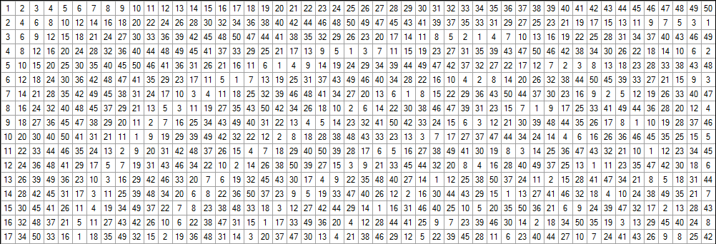
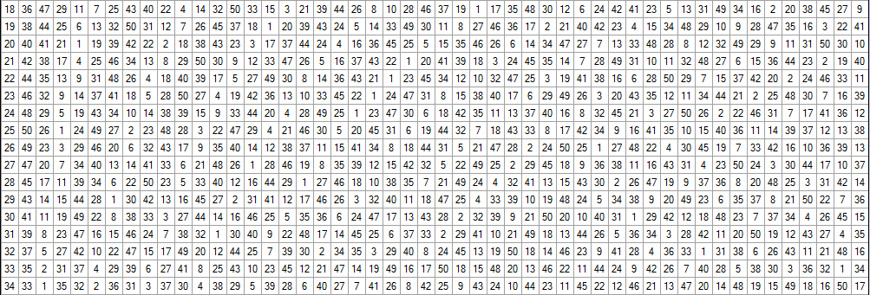
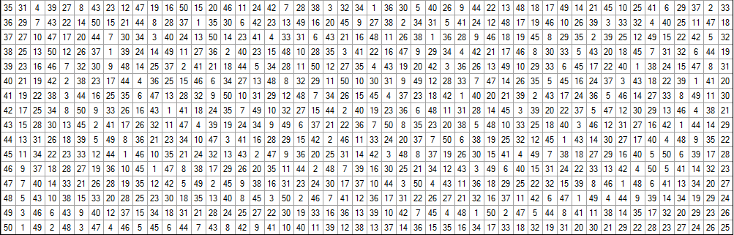
This work: 50x50 in << 1 ms
How?
(Nothing special
about 50x50.
We can do
10Kx10K
in a few seconds.)

Slide 13
Gedanken Experiment:
Given that a constructive algorithm (given any size n) exists, how would you find it? Hwk…
(Can use SAT solver.)
(here)
Notes:
To ground our approach in an example domain, I’ll first introduce the SBLS problem. Some of you might be familiar with this combinatorial structure. First, it’s a Latin square, namely a square grid in which each symbol appears exactly once in each row and column. Moreover,

Slide 14
Outline
Motivation
Example Domain
Proposed Framework
  Overview of Streamlined Search
  Taking advantage of Human Insights
  Formal Description and Overview
  Human-guided Streamlined Search
Application to the Spatially-balanced Latin square problem
Application to the Weak Schur Number problem
Conclusions and Future work

Slide 15
Outline
Motivation
Example Domain
Proposed Framework
  Overview of Streamlined Search
  Taking advantage of Human Insights
  Formal Description and Overview
  GUI for Human-guided Streamlined Search
Application to the Spatially-balanced Latin square problem
Application to the Weak Schur Number problem
Conclusions and Future work

Slide 16
Proposed Framework:
Overview of Streamlined Combinatorial Search
  Goal:
  Exploit the structure of some solutions to boost the effectiveness of the propagation mechanisms.
  Underlying Observation:
  When one insists on maintaining the full solution set, there is a hard practical limit on the effectiveness of constraint propagation methods. Often, there is no compact representation for all the solutions.
  Underlying Conjecture:
  For many intricate combinatorial problems – if solutions exist – there will often be (highly) regular ones. Can we find such solutions?

Slide 17
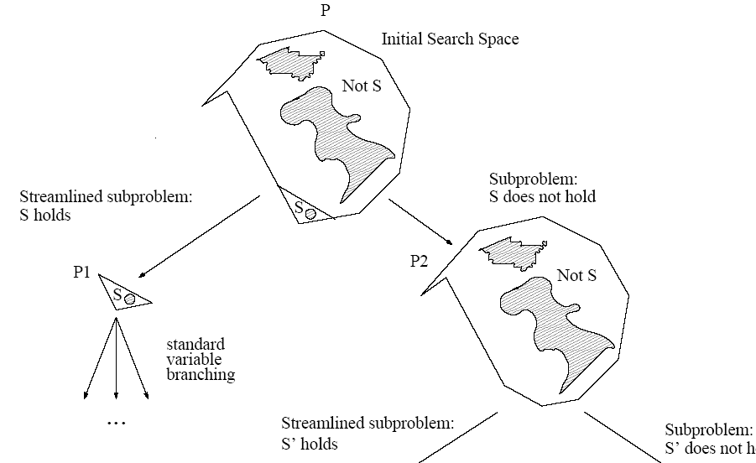
Overview of Streamlined Search
Assert
global property S
(a “streamliner”)
P₁ is substantially smaller than its complement P₂ and it will benefit from a stronger filtering thereafter.
Streamlined Search:
Strong branching mechanisms (by adding constraints based on structure properties) at high levels of the search tree.
[Gomes and Sellmann, CP’04]

Slide 18
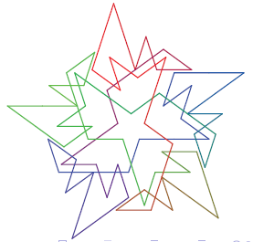
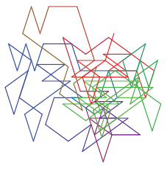
Taking advantage of Human Insights
  Recognizing Patterns and Regularities:
  Correcting Irregularities:
  Generalizing / Formalizing Regularities:
[Source: Marijn J.H. Heule, 2009, in work on van der Waerden numbers]
1 | 2 | 3
3 | 1 | 2
2 | 3 | 1
1 | 2 | 3 | 4
4 | 1 | 2 | 3
3 | 4 | 1 | 2
2 | 3 | 4 | 1
Cyclic Latin square of order 3
Cyclic Latin square of order 4

Slide 19
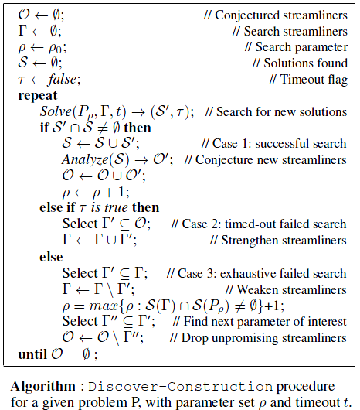
Proposed Framework:
Formal Description and Overview

Slide 20
Overview Approach --- Mimics Alg Discovery
Analyze smaller size solutions, and conjecture potential regularities in the solutions. (Human insight.)
Validate through streamlining the observed regularities.
If the streamlined search does not give a larger size solution, the proposed regularity is quite likely accidental and one looks for a new pattern in the small scale solutions.
Otherwise, one proceeds by generating a number of new solutions that all contain the proposed structural regularity and are used to expand the solution set and to reveal new regularities.
1
2
2
1
3
4
3
4

Slide 21
Proposed Framework for Human-guided Streamlined Search
Overview on the SBLS problem
Search Parameters
Conjectured Streamliners
Solution Set
n=3
Г={}
Start with first order of interest (n=3) and no streamliners (Г={})

Slide 22
Proposed Framework for Human-guided Streamlined Search
Overview on the SBLS problem
Search Parameters
Conjectured Streamliners
Solution Set
n=3
Г={}
Start with lowest order of interest (n=3) and no streamliners (Г={})
Solve for n and Г

Slide 23



Proposed Framework for Human-guided Streamlined Search
Overview on the SBLS problem
Search Parameters
Conjectured Streamliners
Solution Set
n=5
Г={}
{Symmetric, Cyclic}
Start with first order of interest (n=3) and no streamliners (Г={})
Solve for n and Г
{new solutions}
Conjecture new streamliners
{new streamliners, increase n}

Slide 24
Proposed Framework for Human-guided Streamlined Search
Overview on the SBLS problem
Search Parameters
Conjectured Streamliners
Solution Set
n=5
Г={Symmetric}
{Symmetric, Cyclic}
Start with first order of interest (n=3) and no streamliners (Г={})
Solve for n and Г
{new solutions}
{time-out}
Conjecture new streamliners
Strengthen Г
{new streamliners, increase n}

Slide 25
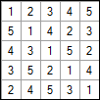
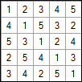
Proposed Framework for Human-guided Streamlined Search
Overview on the SBLS problem
Search Parameters
Conjectured Streamliners
Solution Set
n=6
Г={Symmetric}
{Symmetric, Cyclic, Reduced}
Start with first order of interest (n=3) and no streamliners (Г={})
Solve for n and Г
{new solutions}
{time-out}
Conjecture new streamliners
Strengthen Г
{new streamliners, increase n}

Slide 26
Proposed Framework for Human-guided Streamlined Search
Overview on the SBLS problem
Search Parameters
Conjectured Streamliners
Solution Set
n=6
Г={Symmetric, Cyclic}
{Symmetric, Cyclic, Reduced}
Start with first order of interest (n=3) and no streamliners (Г={})
Solve for n and Г
{new solutions}
{time-out}
Conjecture new streamliners
Strengthen Г
{new streamliners, increase n}

Slide 27
Proposed Framework for Human-guided Streamlined Search
Overview on the SBLS problem
Search Parameters
Conjectured Streamliners
Solution Set
n=63
Г={Symmetric, Cyclic}
{Symmetric, Cyclic, Reduced}
Start with first order of interest (n=3) and no streamliners (Г={})
Solve for n and Г
{new solutions}
{exhaustive failed search}
{time-out}
Conjecture new streamliners
Strengthen Г
Weaken Г
{new streamliners, increase n}
{set next interesting n}

Slide 28
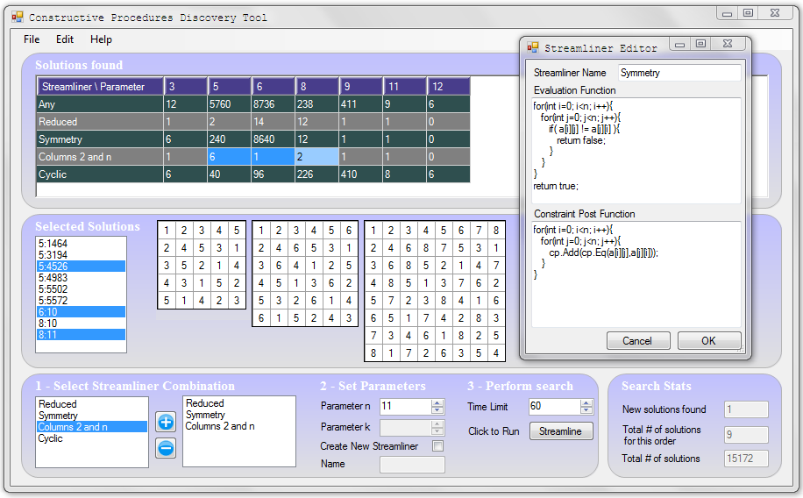
GUI for Human-guided Streamlined Search

Slide 29
GUI for Human-guided Streamlined Search
Conjecture new streamliners

Slide 30
GUI for Human-guided Streamlined Search
Select streamliners, parameters, and perform the search

Slide 31
GUI for Human-guided Streamlined Search
Select solutions

Slide 32
GUI for Human-guided Streamlined Search
Analyze solutions

Slide 33
Outline
Motivation
Example Domain
Proposed Framework
Application to the Spatially-Balanced Latin square problem
  Successful Streamliners
  Constructive Procedure 1
  Constructive Procedure 2
Application to the Weak Schur Number problem
Conclusions and Future work

Slide 34
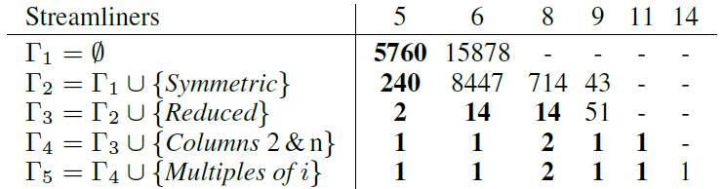
Application to the SBLS problem: Construction 1
Successful Key Streamliners:
{Diagonal symmetry, Reduced form, Assignments of columns 2 and n, Multiples of i in row i, Second sequence decreasing}
Fig: Number of SBLSs generated in 60 seconds, by order and streamliners (Bold indicates exhaustive search).

Slide 35
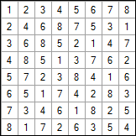
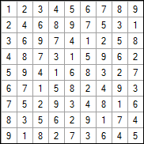
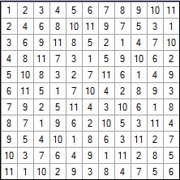
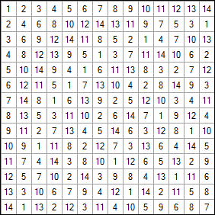
Application to the SBLS problem: Construction 1

Slide 36
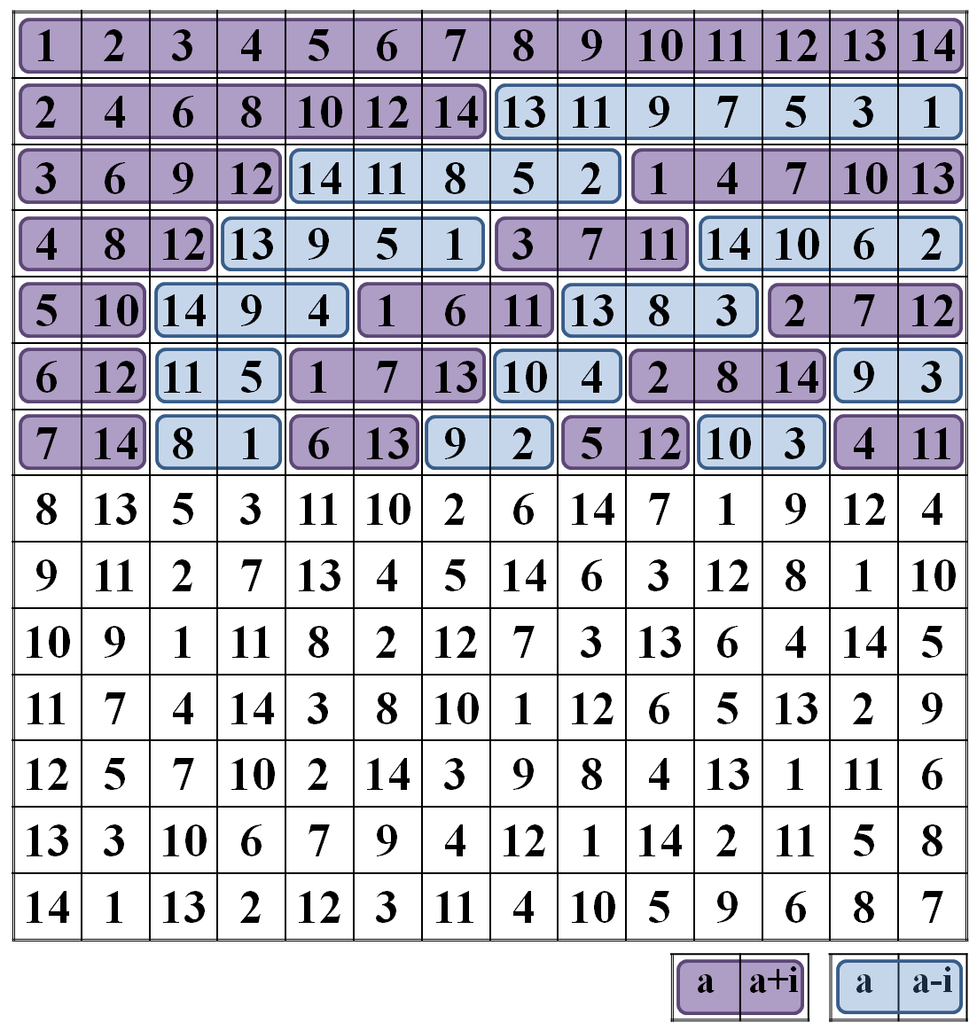
Application to the SBLS problem: Construction 1
Approach reveals patterns. Final step is figuring out boundary conditions.

Slide 37
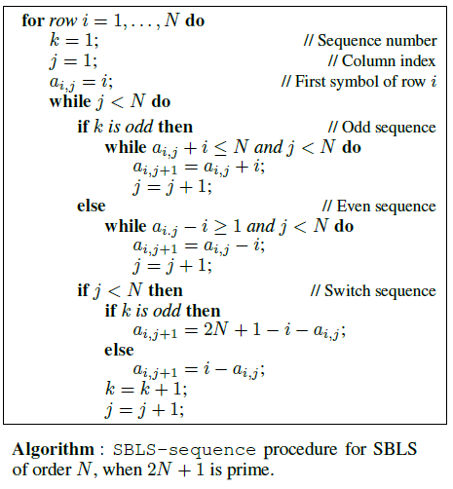
Application to the SBLS problem: Construction 1

Slide 38
Application to the SBLS problem: Construction 1
Proof of Correctness in [R. Le Bras, et al., Polynomial Time Construction for Spatially Balanced Latin Squares, 2012]

Slide 39
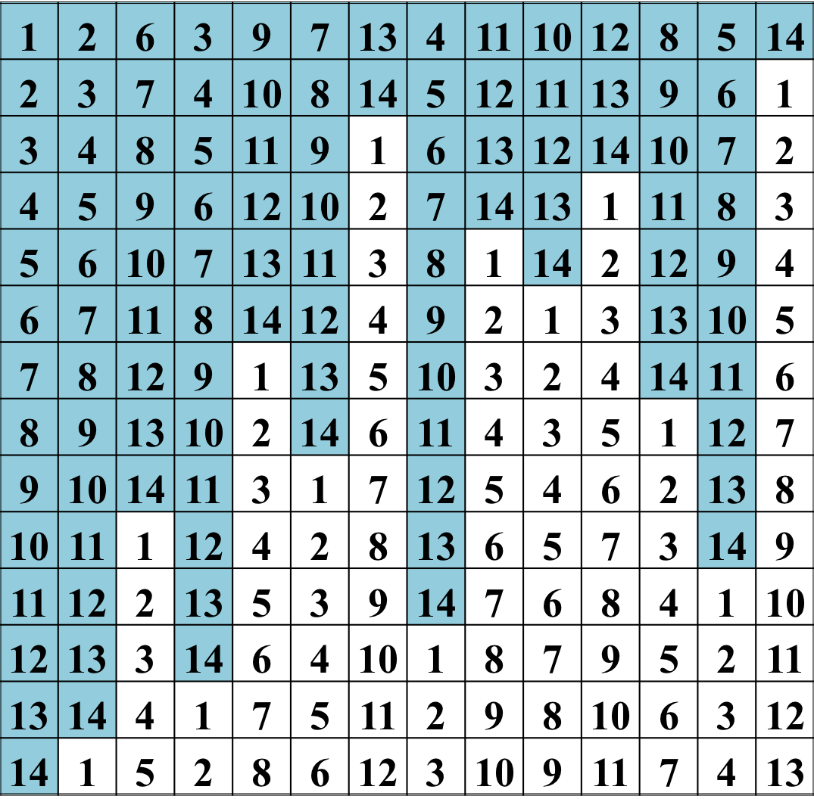
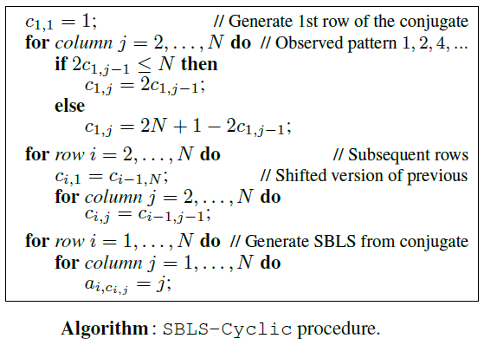
Application to the SBLS problem: Construction 2

Slide 40
Observation I
  Incremental approach in terms of size is necessary:
  Need to reveal structure by generating increasingly larger solutions using increased streamlining (and thus, structure).
  True solution structure only becomes visible around order 14.
  At that size
  Can’t generate any solution of that size without strong streamlining,
  But, even if we could, arbitrary solutions will not show structure.

Slide 41
Observation II
  We conjecture that many hard combinatorial design problems have effective constructive procedures. (E.g., quasigroup existence problems, code design, Ramsey graphs (numbers), van der Waerden, Schur numbers etc.).
  So far, such problems have been tackled with combinatorial search (SAT solvers, equational thm. provers) on a per instance basis. Does resolve open questions in combinatorial design (e.g. new lower-bounds) but does not reveal the general solution structure.
  E.g. Slaney et al. 1993, Herwig et al. 2007, Heule and Walsh 2010
  Eliahou et al. 2012, Fujita et al. 2013.

Slide 42
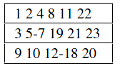
Example: the Weak Schur problem
  Problem Definition:
  A set is (weakly) sum free if for any two (distinct) elements of this set, their sum does not belong to the set.
  The Weak Schür Number of order k, WS(k), is the largest integer n for which there exists a partition of [1,n] into k weakly sum-free sets.
Each of the 3 sets is such that, for any 2 elements of the set, their sum does not belong to the same set.
k=3 sets
Fig: Partition of [1,23] into 3 weakly sum-free sets, proving WS(3) ≥ 23

Slide 43
Application to the Weak Schur problem
  Best known lower bounds:
Approach | WS(5) | WS(6) | Reference
(not disclosed) | 196 | - | [G.W. Walker, AMM’50]
Theoretical bound (not proved) | 188 | 554 | [J.H. Braun, AMM’50]
SAT | 196 | 572 | [Eliahou et al., Computers & Math Applications’12]
Multi-level Tabu-Search | 196 | 574 | [Fonlupt et al., EA’11]
SAT (no certificate) | 196 | 575 | [Eliahou et al., Computers & Math Applications’12] (revised)
New: WS(6) ≥ 581

Slide 44
Successful Key Streamliners:
{Ordered sets, constrained minimum of each set, partial assignments, sequences of consecutive integers, sequence interleaving}

Slide 45
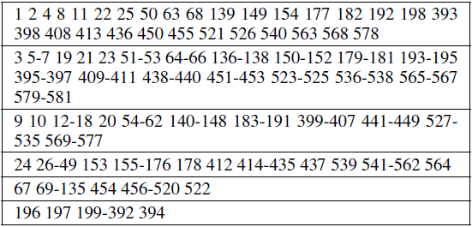
Application to the Weak Schur problem
Successful Key Streamliners:
{Ordered sets, constrained minimum of each set, partial assignments, sequences of consecutive integers, sequence interleaving}
Partition of [1,581] into 6 weakly sum-free sets, proving WS(6) ≥ 581.
(le Bras, Gomes,
Selman AAAI 2012)
Incrementally obtained, although not an example of a fully constructive procedure yet, any progress on Schur numbers is quite significant given their long history.

Slide 46
Summary
Structure discovery through a general framework that integrates streamlined combinatorial search with human insight and intuition in an iterative approach to discover efficient constructive procedures.
Provides the first constructive procedures for the Spatially-Balanced Latin Square problem.
Also, improves the best known lower bound for the Weak Schur Number problem, and, most recently, for “Graceful graphs.”

Slide 47
Extensions crowd-source the search for regularities in the solution sets (on Mechanical Turk).
And much, much more ambitiously…
--- Ramsey numbers (Erdos), and
--- possibly, new types of algorithms.

Slide 48
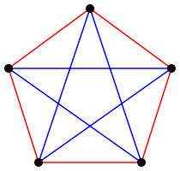
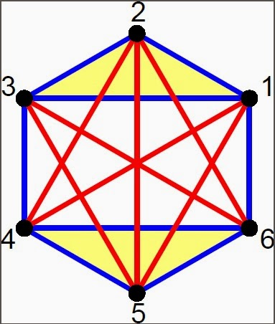
here
6+ nodes
always a blue or red triangle
R(3,3) = 6
5 nodes
red/blue edges
no blue or red triangle
Ramsey theory about “forced” structure
“unavoidable structure in our universe”
  Erdos: "Imagine an alien force, vastly more powerful than us landing on Earth and demanding the value of R(5, 5) or they will destroy our planet.” [hmm?]
  In that case, we should marshal all our computers and all our mathematicians and attempt to find the value. …
  But suppose, instead, that they asked for R(6, 6), then we should attempt to destroy the aliens".
  Situation is probably not quite as dire. ☺
  The key will be to find the hidden structure in the solution space.
R(3,3) = 6
R(4,4) = 18
R(5,5) = ?

Slide 49
Part II:
Crowdsourcing for Backdoor Variables:
Materials Discovery Domain
Briefly!
Warning: Real-world, noisy data ahead

Slide 50

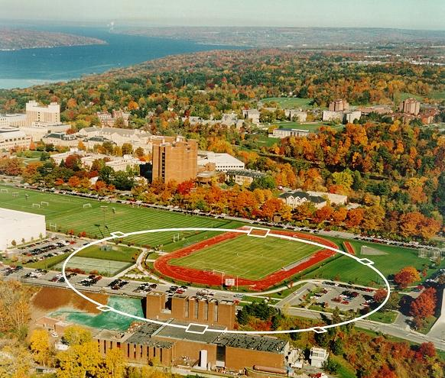
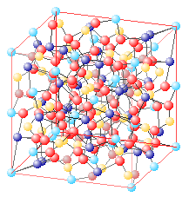
Motivation
Study of new materails:
Identifying crystalline structure using X-Ray Diffraction patterns
Rh
(38% Ta, 45% Rh, 17% Pd)
With Caltech, working
on screening 1 million
samples per day.
[Source: Pyrotope, Sebastien Merkel]
Ta
Pd

Slide 51
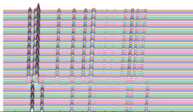
Phase Map Identification Problem
INPUT:
Additional Physical Requirements:
Phase Connectivity
Mixtures of ≤ 3 pure phases
Peaks shift by ≤ 15% within a region
  Continuous and Monotonic
Small peaks might be discriminative
Peak locations matter,
more than peak intensities
Al
Fe
Si
Collection of X-Ray diffraction
Patterns. Noisy and hidden
structure.
OUTPUT:
pure phase
region
m phase regions
⋅ k pure regions
⋅ m-k mixed regions
Al
Mixed
phase
region
Fe
Si

Slide 52
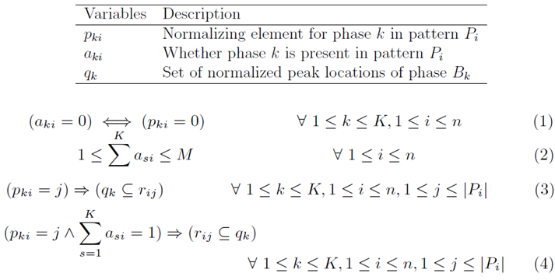
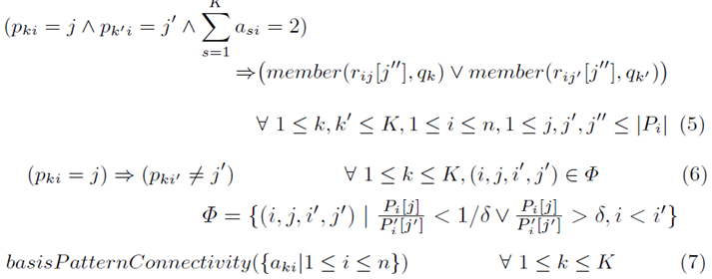
Complex Full Constraint Optimization Model
Drawback:
Does not scale to full-scale realistic instances; poor propagation of experimental noise.
Advantage: Captures physical properties and relies on peak location rather than height.
Drawback: Does not scale to realistic instances; poor propagation if experimental noise.

Slide 54
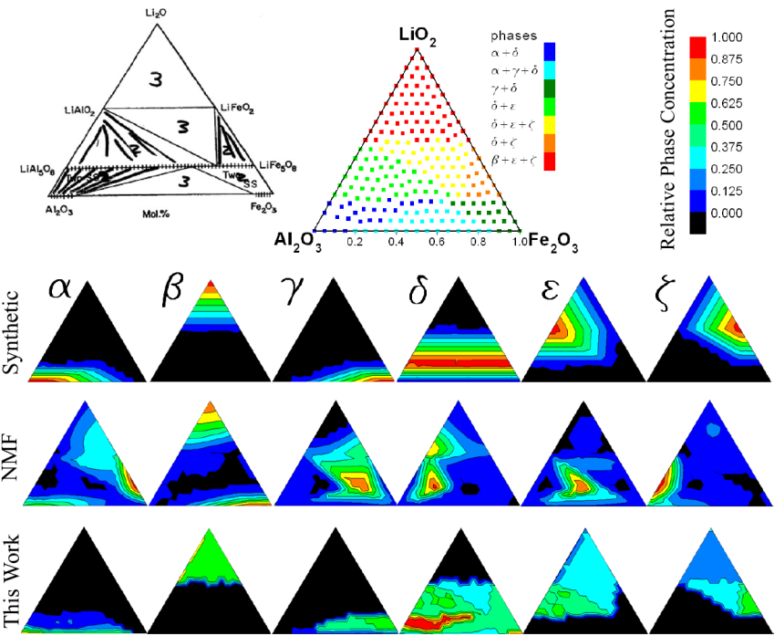
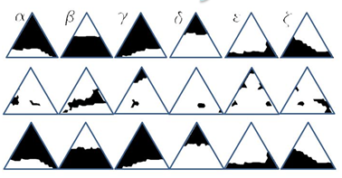
SAT Modulo Theory (SMT) Approach:
Experimental Validation
Al-Li-Fe instance
with 6 phases:
Ground truth
(known)
Previous work
(ML Based approaches)
violates many
physical requirements
Our SMT
approach is much
more robust

Slide 55
UDiscoverIt:
  Can human input boost the performance of combinatorial reasoning and optimization methods (SMT)?
  Human input about potential grouping of diffraction peaks
  collected on Amazon’s Mechanical Turk. (About 500 patterns)
  Provides info on potential so-called backdoor variables.

Slide 56
Human input can dramatically speed up the performance of combinatorial optimization methods (identification of backdoor variables).
Leverages the complementary strength of human input, providing global insights into problem structure, and the power of combinatorial solvers to exploit complex constraints.
Note: Human input identifies subsets of peaks that (quite likely) go together.

Slide 57
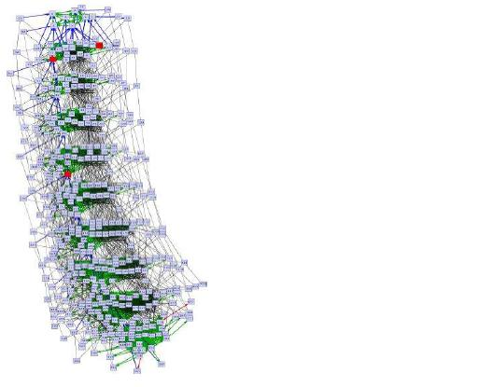
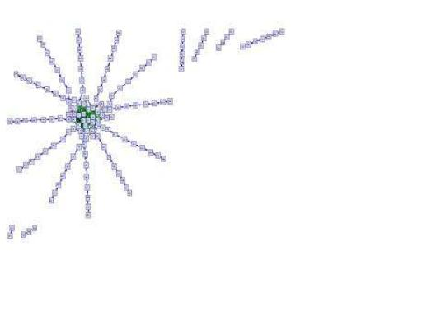
Observation
  Visual representation allows human input to be effective in discovering structure and setting backdoor variables in this domain.
  Contrast with earlier work:
  SAT encodings of planning problems. It was very difficult to give any semantic interpretation to the backdoor variables of the problem instances. Synthetic planning formulas with log(n) size backdoors (provably).
Setting 2 out of 392 variables.
(Hoffmann, Gomes, Selman AIPS-06)

Slide 58
Conclusions
  We have discussed how human insights can be combined with
  reasoning and optimization methods for scientific discovery.
  Finite Mathematics --- Obtained first procedure for Spatially Balanced Latin Square construction.
  Materials Discovery --- Boosted interpretation of X-ray diffraction patterns with crowdsourced input.

